Slide 1
Public Records and Private Interests
Katherine Fink
Pace University
Presentation to Joint Journalism and Communication History Conference
March 21, 2015

Slide 2
Types of FOIA requesters
Coalition of Journalists for Open Government, 2006

Slide 3
Pre-FOIA disputes
Who has the right to examine public records?
What are valid reasons to grant access?
Are people allowed to make copies?
To what extent must officials accommodate requests?

Slide 4
“The Title Company’s Clerks”
New York Times
July 30, 1885
During the past week books were taken from five clerks of the company an aggregate of 480 times, the same book being taken as many as eight or ten times from one clerk on the same day.
The Register also laid down a rule that clerks of
the Title Company wishing to consult books
should obtain the permission of the custodian.
This official often could not be found…
The Register also determined that only four of the Title Company’s clerks should work in the office at one time, as he did not care to watch any more than that number.

Slide 5
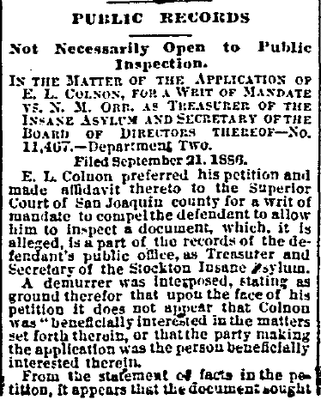
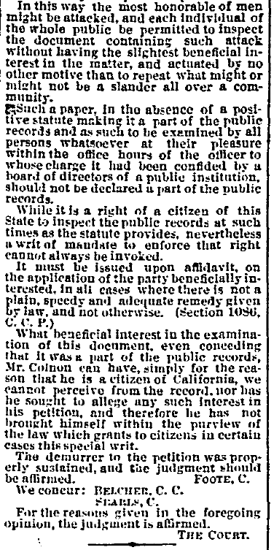
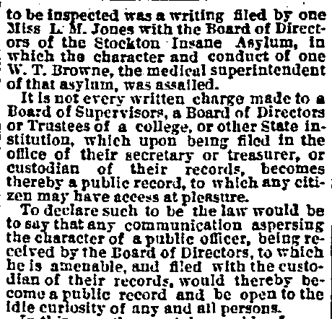
“Public Records”
San Francisco Chronicle
September 29, 1886
“…the most honorable of men might be attacked, and each individual of the whole public be permitted to inspect the document containing such attack without having the slightest beneficial interest in the matter…”

Slide 6
“Fight To Guard Public Records” Chicago Daily Tribune
April 7, 1905
“The point to be determined is whether the trust company has an unrestricted right of
access to these records for its own use…”
“…to occupy space to the disadvantage of the public in general, and, at times, of the working force of the recorder's office."

Slide 7
Pre- Present Day FOIA disputes
Who has the right to examine public records?
What are valid reasons to grant access?
Are people allowed to make copies?
To what extent must officials accommodate requests?

Slide 8
Federal, state officials can’t keep up
Response in 20 working days: 73% compliance
11 of 15 agencies have outdated regulations
Electronic reading rooms often out of date, not searchable
Processing scores down for 8 of 15 agencies
Center for Effective Government, “Making the Grade,” 2015

Slide 9
Ferguson (Mo.) faced 3000+ requests
City Attorney Stephanie Karr:
"They wanted to cause trouble, interrupt our operation from really important functions… They were turning this around and completely perverting the entire purpose of the Sunshine Law."
Salter and Lieb, “Ferguson flooded with record requests after Brown shooting,” Associated Press, March 16, 2015

Slide 10
Thank you!
kfink@pace.edu
@katherinefink

